Slide 1

Project 3 Covid-19
James Fairgrieve
Clifford Sepato
Adam Fletcher
Khadiza Begum

Slide 2



Agenda
Data resources
SQL database
Flask
Visualisation
Presentation

Slide 3
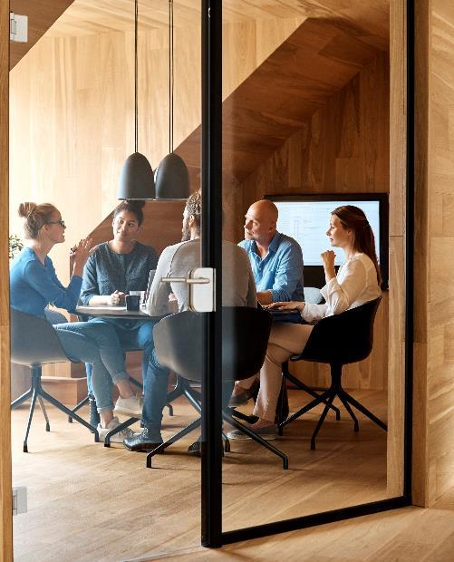



Introduction
The Covid-19 theme has undoubtedly been very popular since the end of 2019. There is now a lot of data and among them we selected WHO to prepare our project. We found the data reliable and containing interesting possibilities of presenting them in the context of data analysis and interactive visualizations.

Slide 4

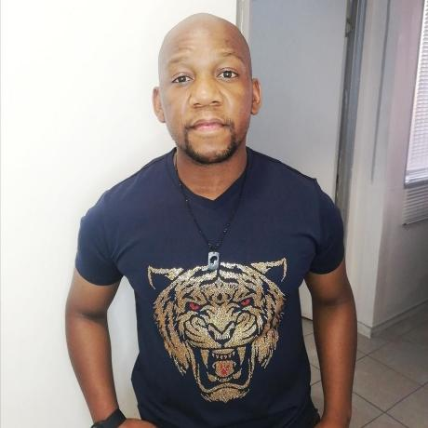


Team
Name
Name
Name
Name
James Fairgrieve
Clifford Sepato
Adam Fletcher
Khadiza Begum

Slide 5
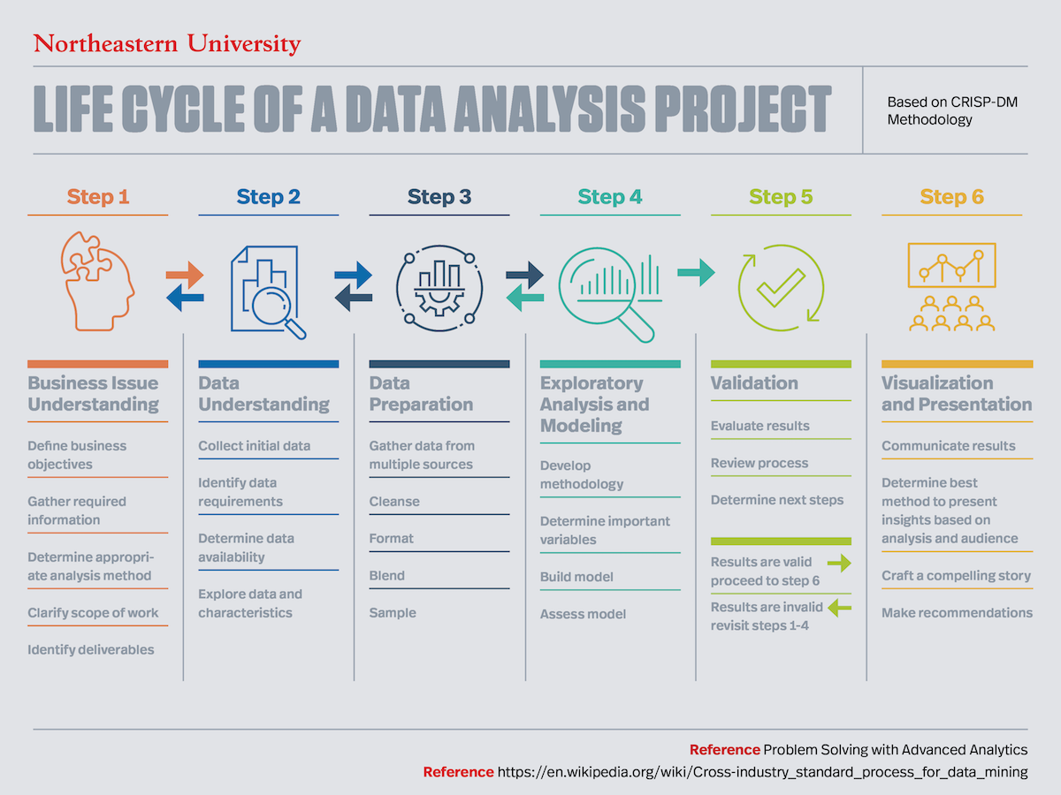
Life cycle of a data analysis project

Slide 6

The way to get started is to quit talking and begin doing.
Walt Disney

Slide 7

Data resources
WHO data

Slide 8
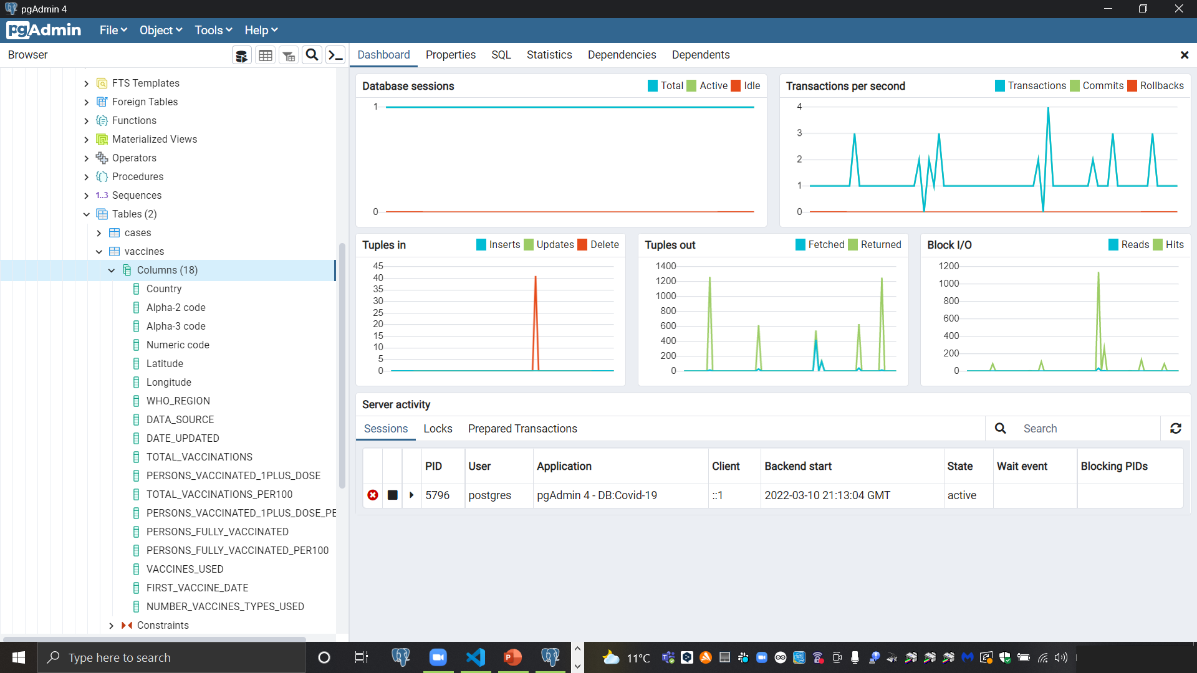
Creating database

Slide 9
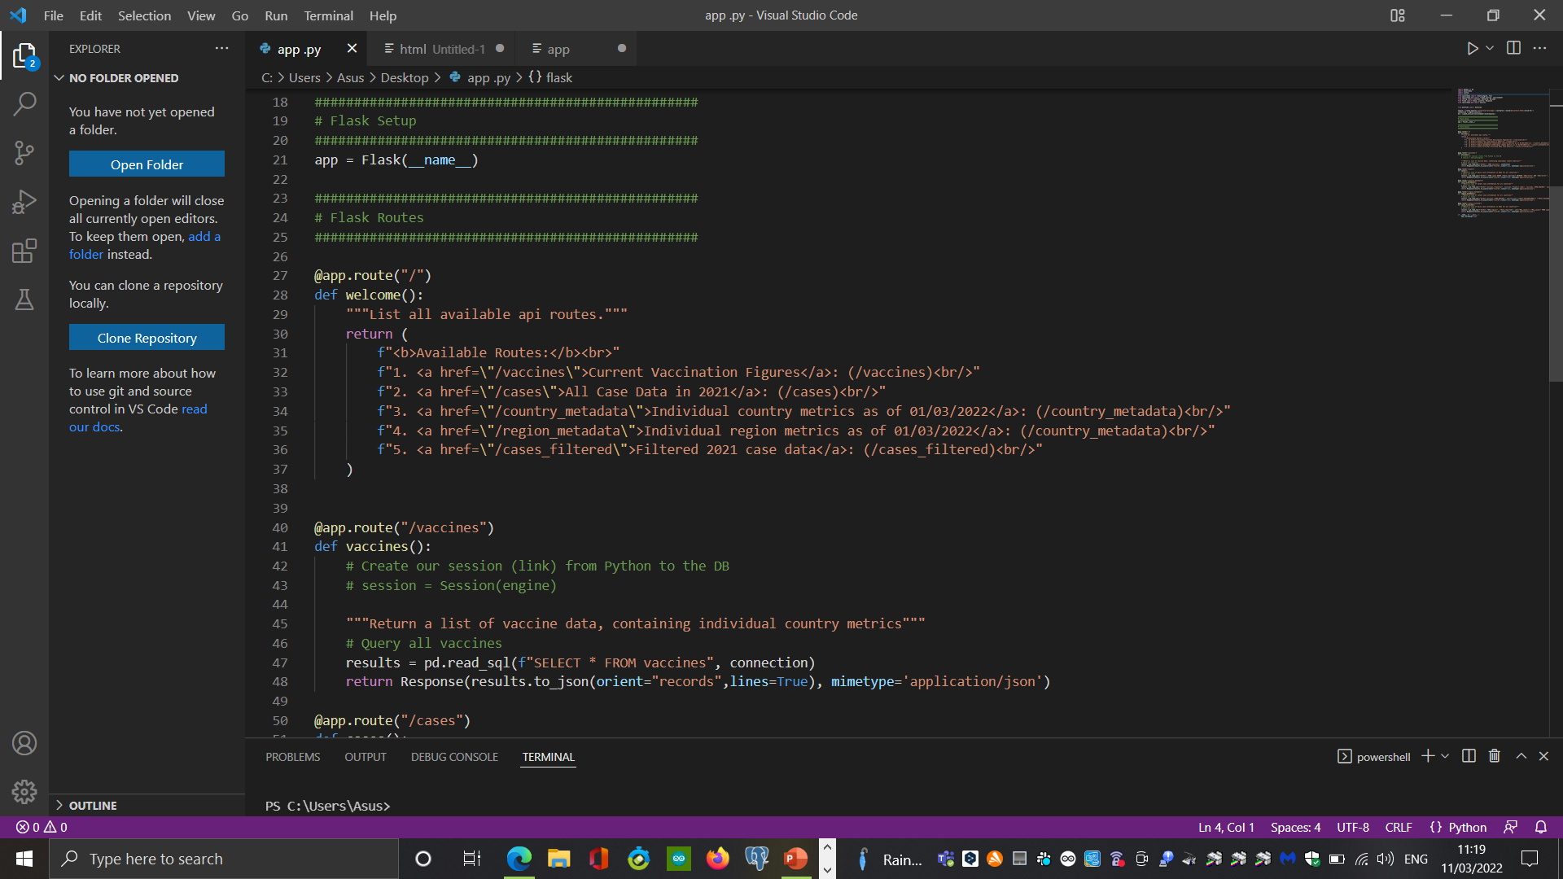

Flask

Slide 10
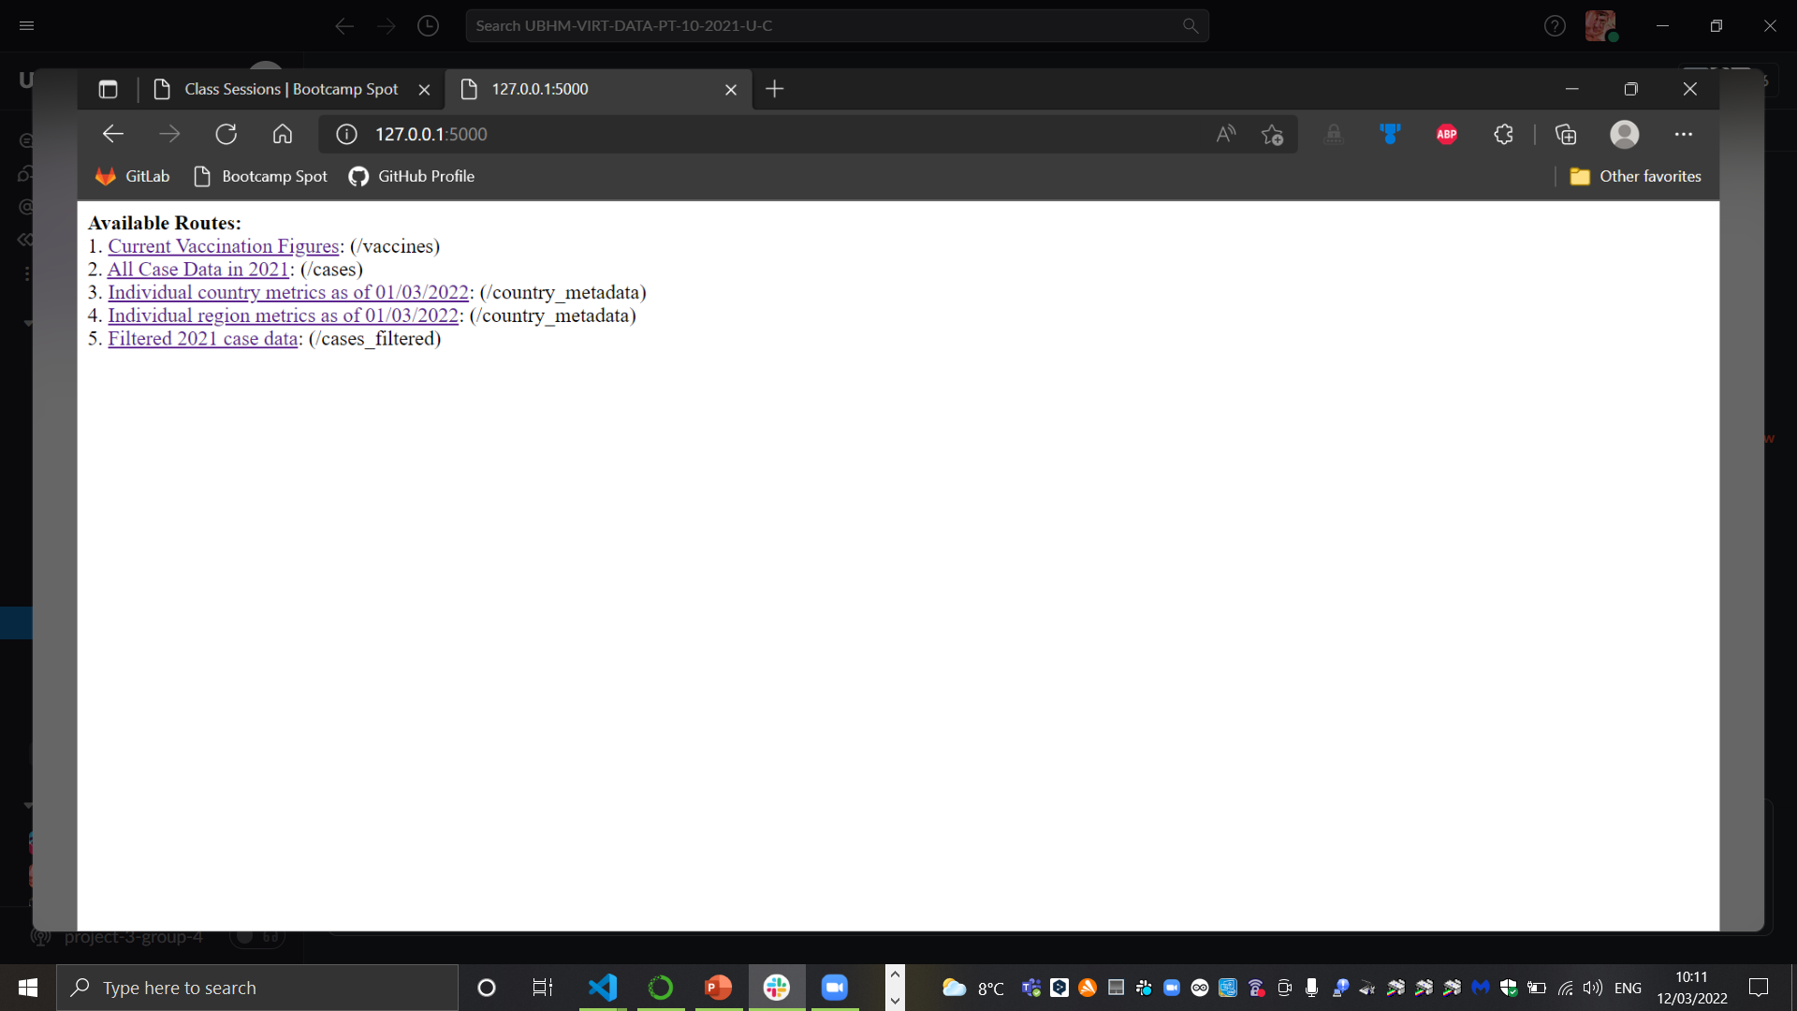
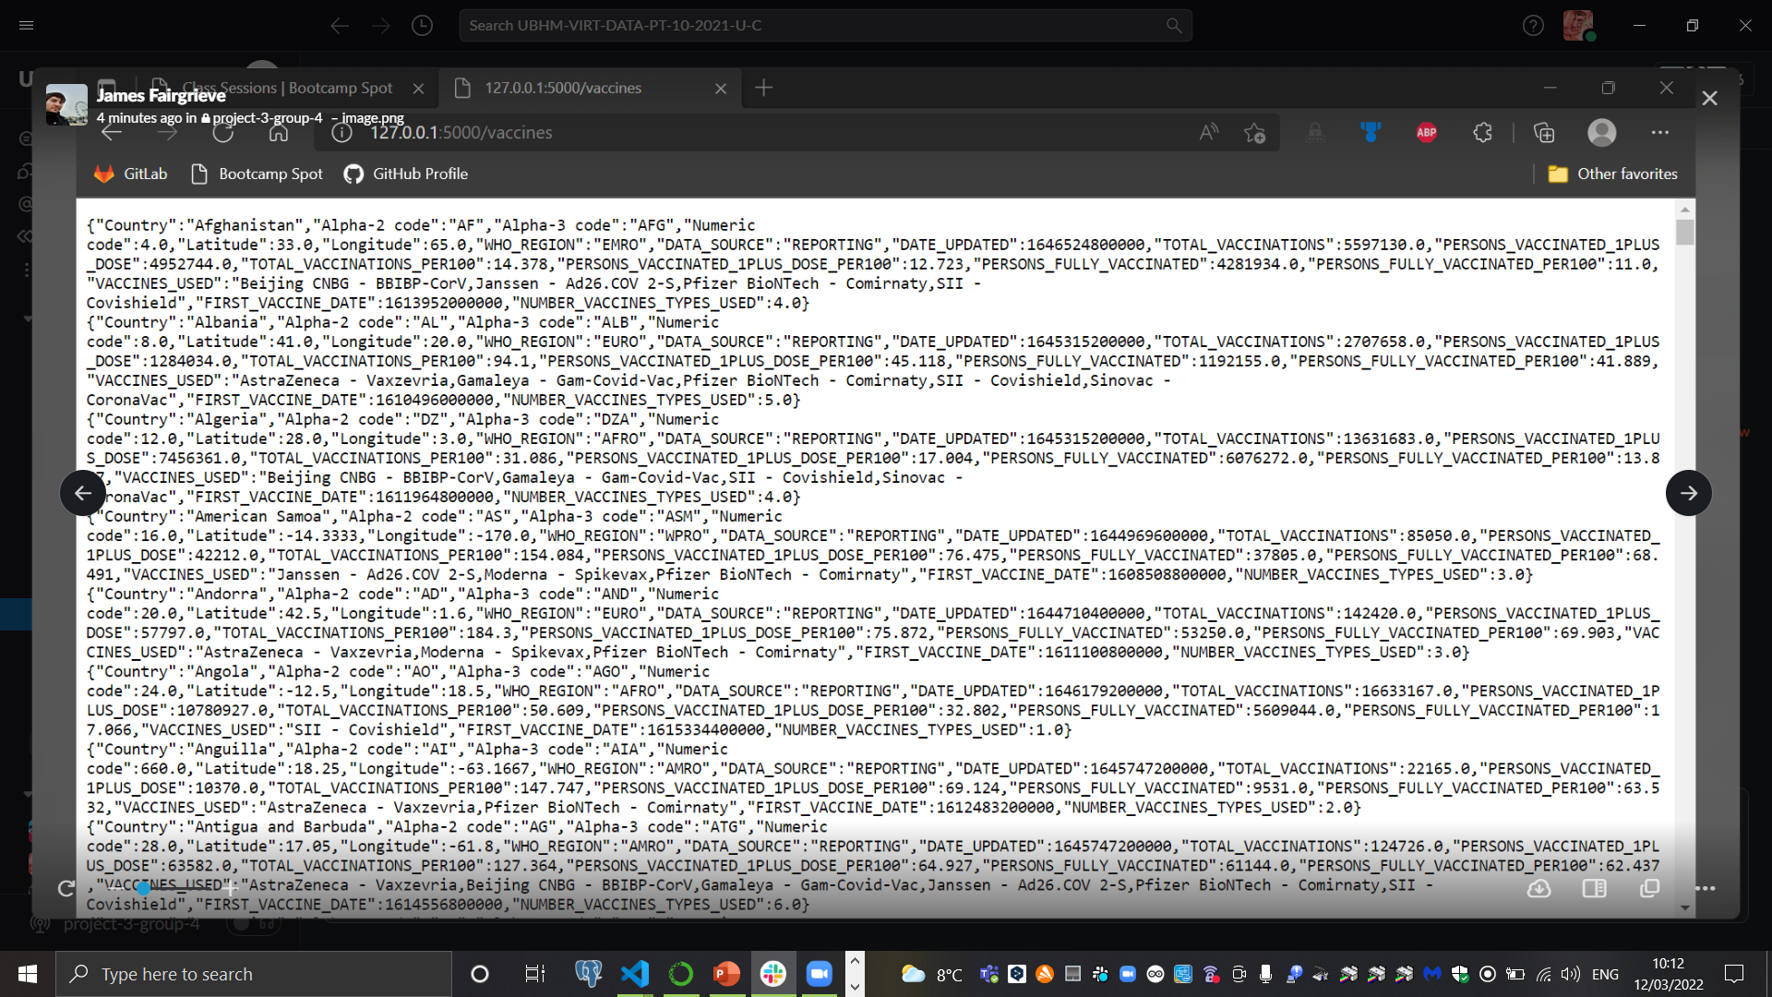
Page with available routes and data

Slide 11
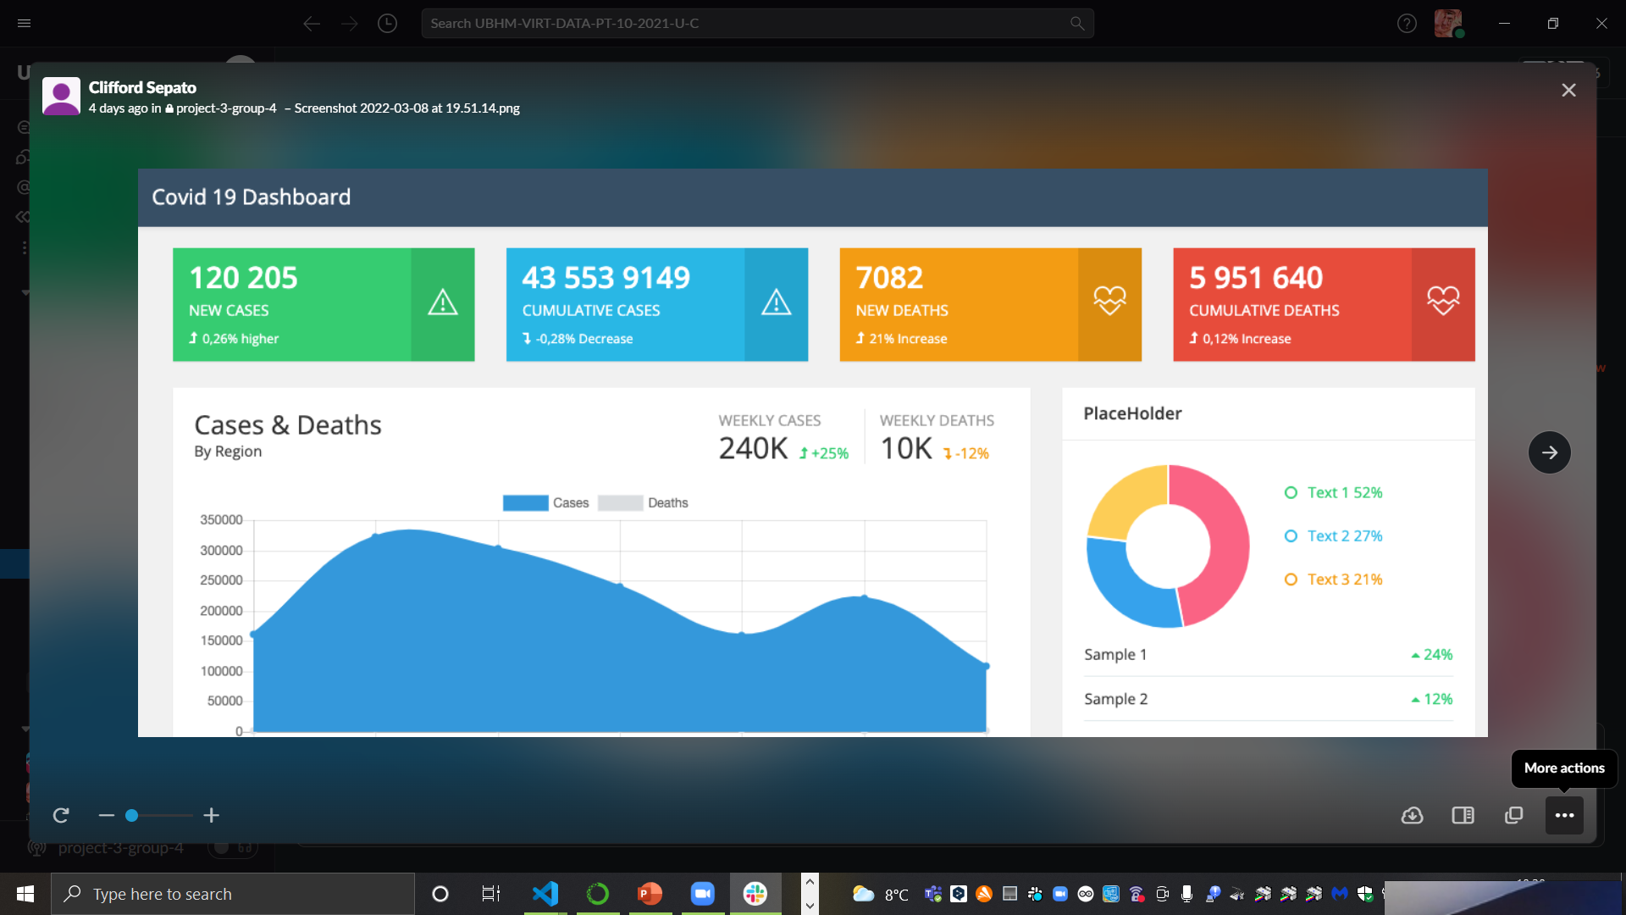
Visualisation

Slide 12
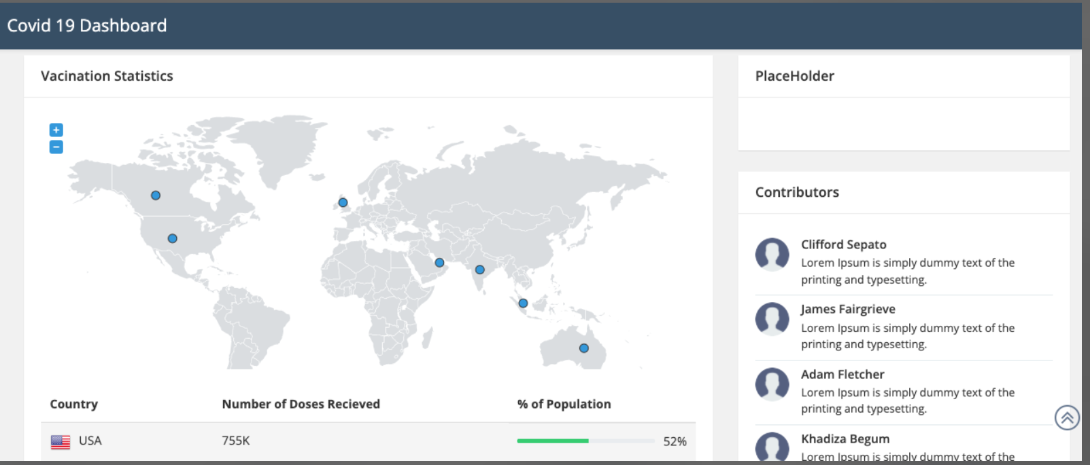
Covid 19 Dashboard

Slide 13
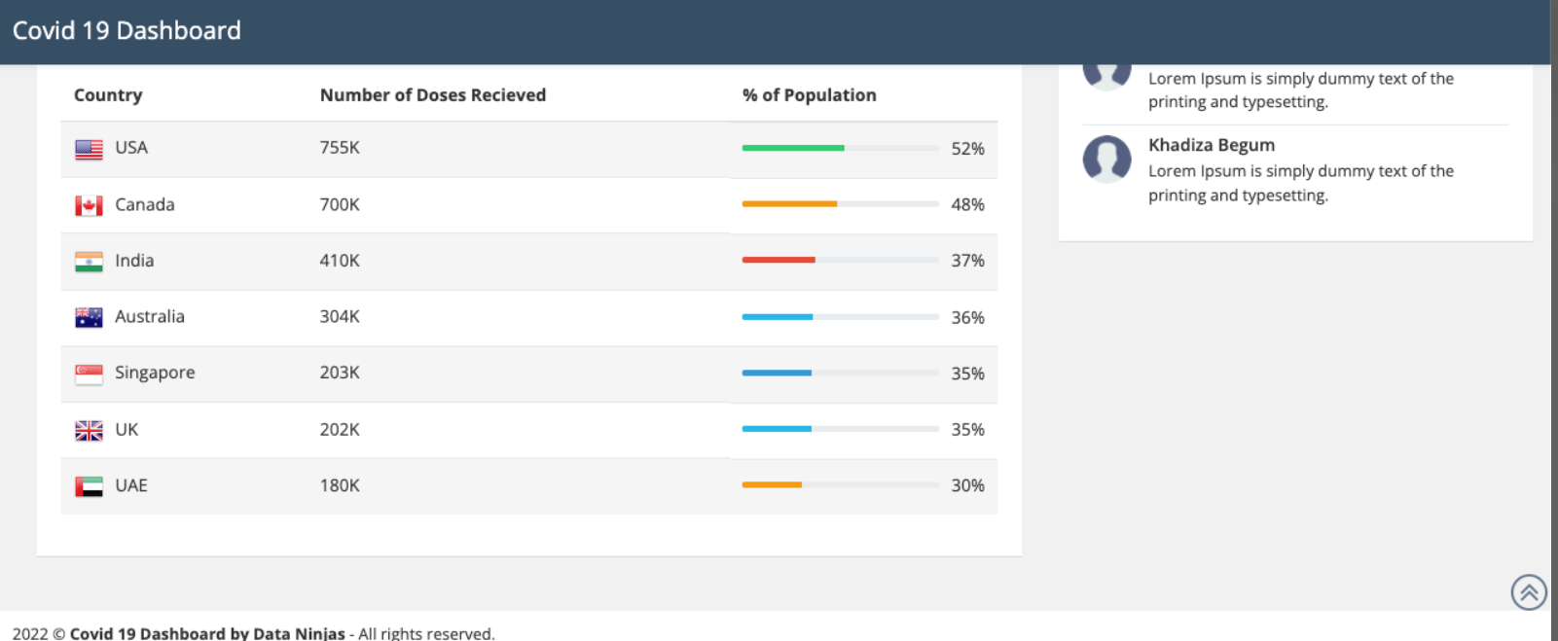
Dashboard

Slide 14

Summary
We created pgAdmin database Covid 19 including csv data files. Subsequently we created app.py flask connecting database. Later we created html file and visualisation.

Slide 15


Thank You
Project3_Group-4
LostPlotly

